Slide 1




Target Marketing and Demand Forecasting for a Plumbing and Drain Services Company
Business Analytics in Retail and Marketing
By
Dushyant, Kiran, Prasanta & Nirav
January 2018
Presented towards partial fulfilment for award of PGPBA by GLIEMR

Slide 2

INDEX
Objective
Executive Summary and key findings
Data Summary and Preparation
Exploratory Data Analysis
Hypothesis Testing
POC, Modelling and Evaluation
Conclusion/Recommendation

Slide 3
Objective
The owner of Plumbing & Drain Service company (PDS) wants to use their past transaction data to come up with a set of recommendations that can help his business increase their revenues, build customer base, control customer churn, forecast service demand, launch Annual schemes for customers and target marketing.

Slide 4
Data Source
Data is provided by UST Global, - United States based multinational company providing Digital, IT services and solutions
Global outreach, operations in USA, India, Mexico, UK, Malaysia, Philippines, Singapore, Spain and Poland
Specializes in Healthcare, Retail & Consumer Goods, Banking & Financial Services, Telecom, Media & Technology, Insurance, Transportation & Logistics and Manufacturing & Utilities sector
The data being studied belongs to an on-demand plumbing services company that is based in US
The name of the company, customer information, job types, and types of service provided by the company masked due to data secrecy mandates

Slide 5
Executive Summary and key findings
Plumbing Business Analysis

Slide 6
Executive Summary and key findings
Three-year data: Analysis is performed on three years data starting Jan 2011 to Dec 2013 for the Plumbing & Drain Service company (PDS).
No Significant trend/seasonality visible- Overall business reasonably flat, total revenue $ 2.24 million from 1058 unique customers who make 5069 service calls in three years.
Reasonable coverage throughout the United States, presence in 28 states, and operates 47 branches
On a typical year – 63% of service calls are received from returning base and 37% new.
> Almost 70% of new customers a year are acquired as diligent or Savvy base.

Slide 7
Executive Summary and key findings
Day of week and Hour of day analysis suggests – Mondays make more business compared to other days of week (on avg. 37% more service call on Mondays)
> Morning from 7AM till late afternoon sees maximum calls peak around 11AM (82% of total calls)
> Almost 42% of total calls/revenue are with Job code 2,1 and 0 in respective order.
> 57 % of total service calls across branches/states is by Customer type 1
Analysis able to explains about 99% of the variation in data accurately to predict customer Churn.

Slide 8
Data Summary and Preparation
Plumbing Business Analysis

Slide 9
Data Summary and Preparation
We have used Plumbing Master Data V0.2.xls file for our analysis
Total 5284 records/observation
Observations were spread from year 2010 to 2014
31 variables of mixed datatypes
7 categorical, 7 Date, 4 time variables and others masked customer information variables

Slide 10
Data Summary and Preparation
Missing/misleading value treatment: Treated/replaced records~500 having Schedule time as 5AM with Avg. difference between schedule call time and Dispatched calls time
Also, treated Call date/time, Schedule date/time, dispatch date/time and complete date/time and last service date as per their order for incorrect records.
Outlier treatment: Fixed records having incorrect date/year based on rest date and time features. e.g. Call date 10/02/2011 and complete date 11/04/2019 etc.

Slide 11
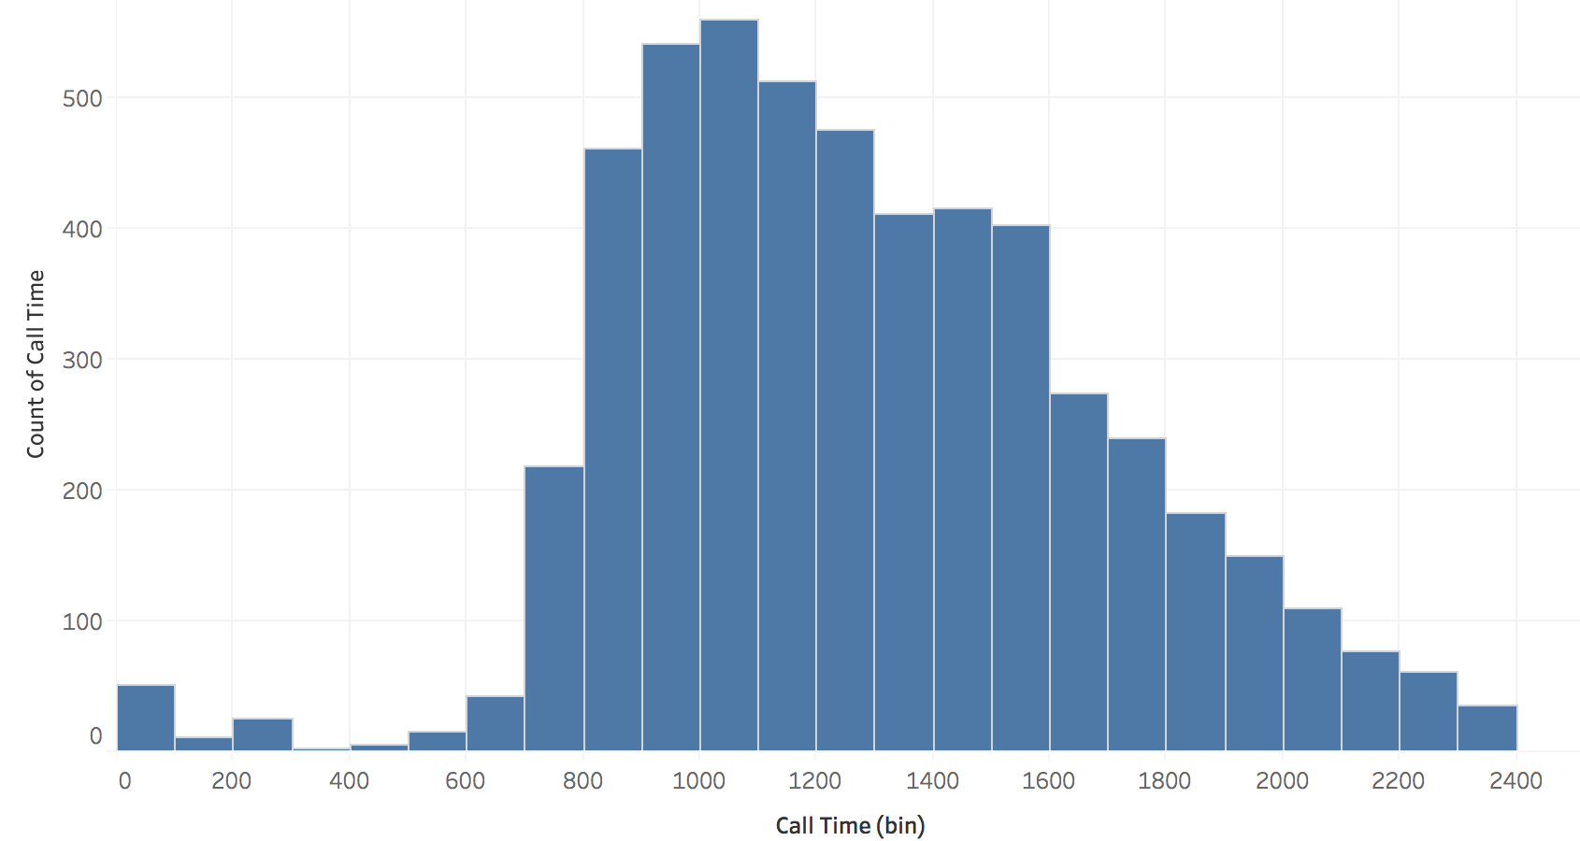
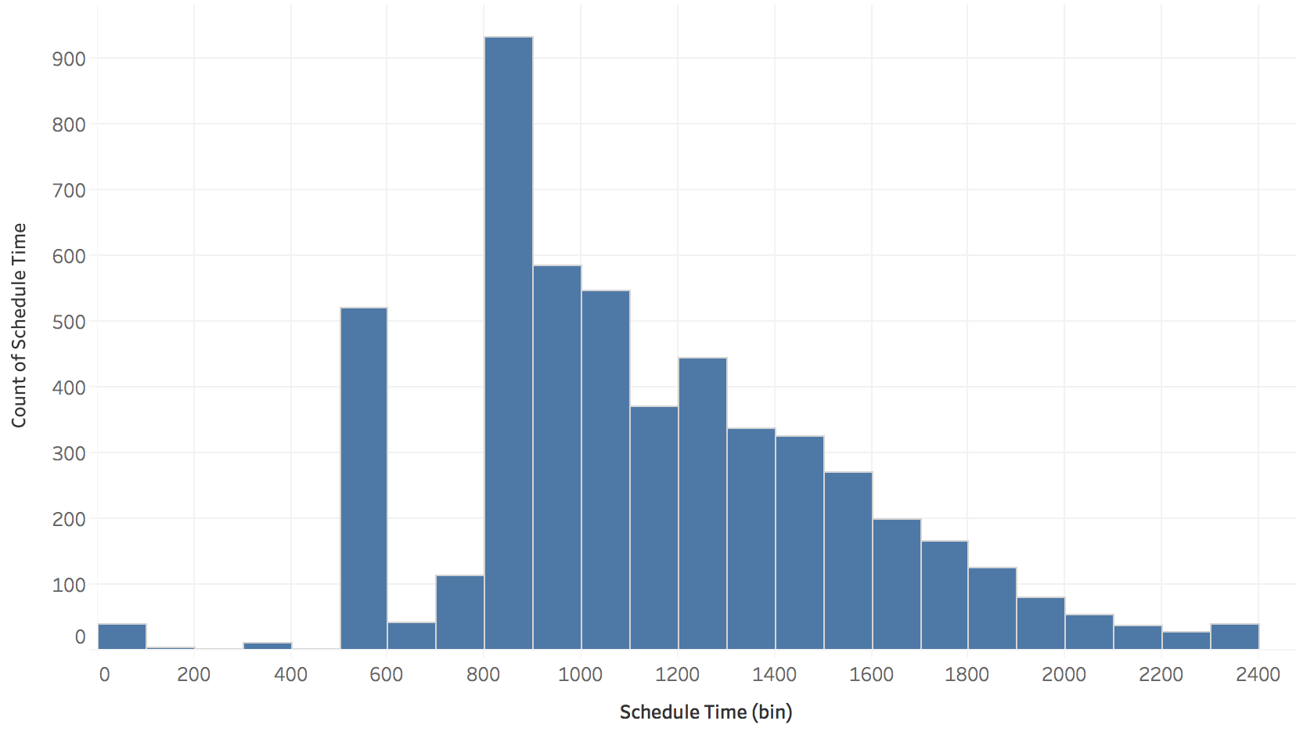
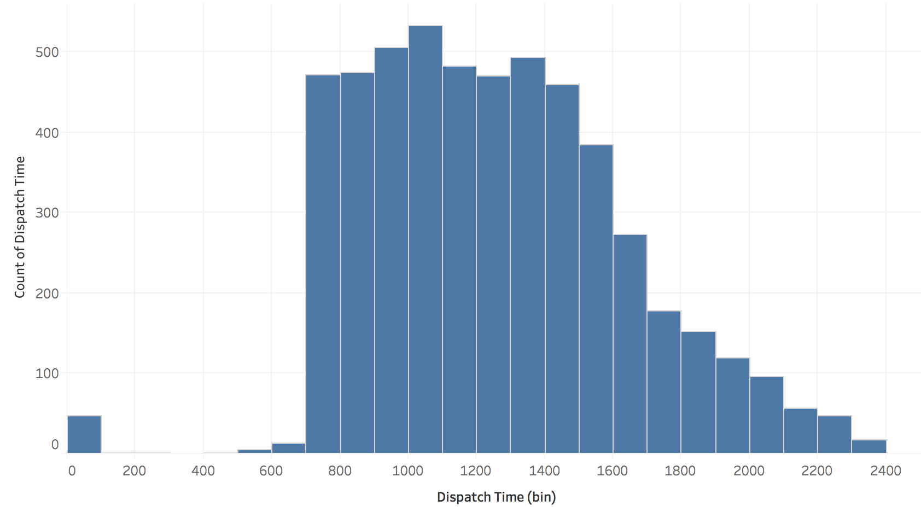
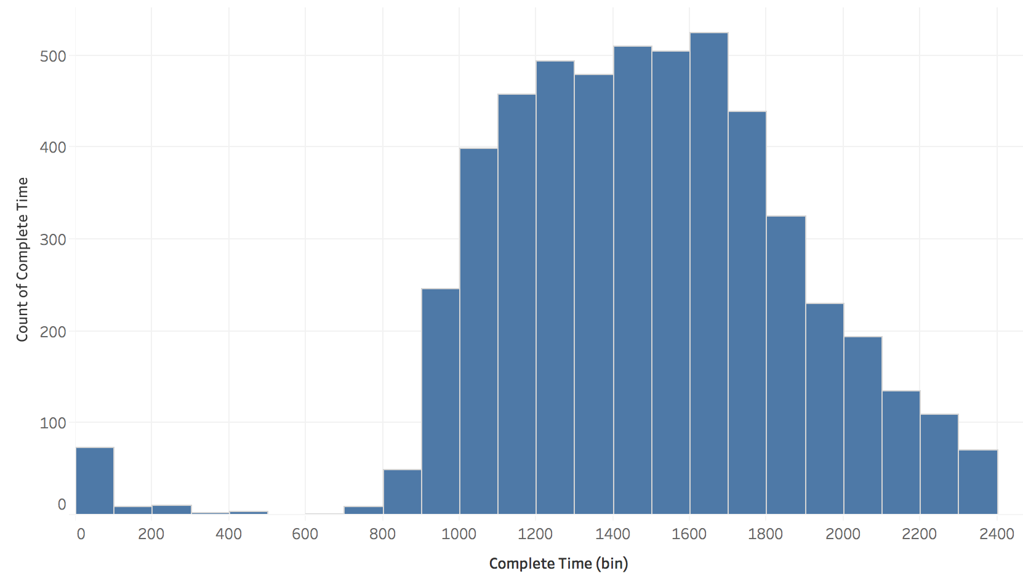
*Treated
(500+ scheduled calls at 5AM)
Notes:
*Treated: Reviewed Call time and Dispatch time for scheduled calls at 5AM and replaced them with avg. difference time between schedule and dispatch randomly.

Slide 12
Data Summary and Preparation
Converted all date and time variables in correct form
Added Rounded time dummy variable for Day of week and time of day analysis.
Dropped 212 records of year 2010 and 2014.
Created new dummy features based on our hypothesis (refer Hypothesis section)

Slide 13
Target/Churn Definition
Our definition of churn can be translated into the following rules:
The Churn variable (i.e the one we want to model) is built by looking back over a 6 month period from a reference date, and flagging the customers with a “0” if they used our service on this time frame and “1” otherwise i.e. churned.
We have restricted our data to the customers who made more than one service calls from start date, and total purchases at least 30 in value. This rule is to make sure we only look at the high value customers.

Slide 14
Feature | Description
Customer ID | Unique ID for each customer
Cust Life Time | Years given customer used service
Last Service Date | Date when last service request complete for customer
Last Service Month | Month when last service request complete for customer
ShowInPrevYear | Binary variable to flag customer shown in last year
ShowInCurrentYear | Binary variable to flag customer shown in current year
CntOfDistinctJobs | No. of different service Jobs used by customer
Customer Type | Given customer Id belogs to which type: Type1, type2 or type3
DaysSinceLastCall | This should be calculated runtime when we decide to run model : Numer difference between ( Today's date - last service date), here we considered Todays date as 31-12-12(Train), 31-12-13(Test)
ServiceDelayInHrs | Sum of total service delay in hours for custome (Dispatch time minus Schedule time)
AvgHrsToCompleteJob | Average hours taken to complete job for given custormer
AvgLatencyInDays | Average number of days between calls for given customer
IsCalledOnMon | Binary variable to flag customer called on Monday
IsCalledOnTue | Binary variable to flag customer called on Tuesday
IsCalledOnWed | Binary variable to flag customer called on Wednesday
IsCalledOnThu | Binary variable to flag customer called on Thursday
IsCalledOnFri | Binary variable to flag customer called on Friday
IsCalledOnSat | Binary variable to flag customer called on Saturday
IsCalledOnSun | Binary variable to flag customer called on Sunday
Sum of Ticket Revenue | Sum of total revenue generatged from given customer
Count of Call Date | Number of calls made by given customer
Churn | whether customer has churned or not: 1 - churned, 0 - Returning

Slide 15
Data Summary and Preparation
Data preparation :
# Creating Development and Holdout Sample
> Development(Train): All call records in year 2011 and 2012
> Holdout(Test): All call records in year 2013

Slide 16
Exploratory Data Analysis
Plumbing Business Analysis

Slide 17
Exploratory data analysis (EDA): geographical presence
Top 5 States
Geographical presence: 28 states, 47 branches, 1058 customers, 5069 calls, $ 2.24 million

Slide 18
Service calls for Jan 2011 till Dec 2013
Randomly Distributed
Years total : Service Calls: 5069 Revenue($): 2,274,459

Slide 19
Service calls throughout week shows decreasing trend
On avg. 38% more calls on Mondays
Avg. weekly total : Service Calls: 33

Slide 20
Service provided throughout day
Rush hours
NO show on scheduled time
by late evening most jobs complete
Ad-hoc nature of business
Avg. Daily total : Service Calls: 4.76 Scheduled Calls: 4.74 Dispatched Calls: 4.75 Revenue($): 2,124

Slide 21
Sales drilled down to per bill/transaction level
Avg. revenue per bill is $340
Type 1 customers dominate throughout

Slide 22
Business from Customer types across geography
Most Contributing type
Avg. weekly revenue($): CustType01: 1,138 CustType02: 322 CustType03: 678

Slide 23
Top revenue generating Job codes
86% of total revenue belongs to above codes

Slide 24
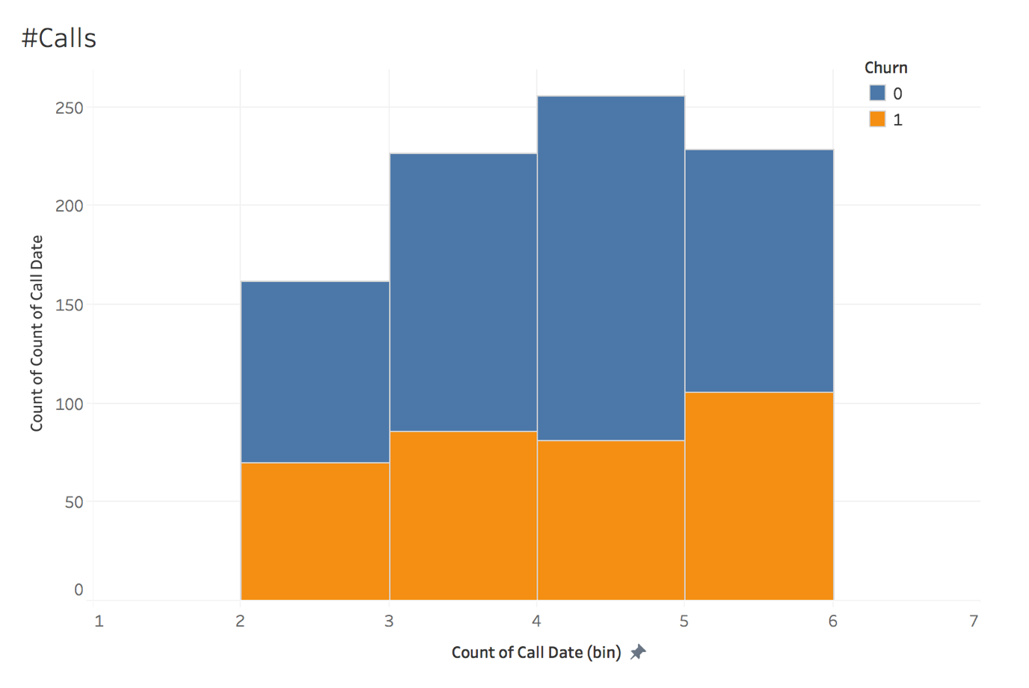
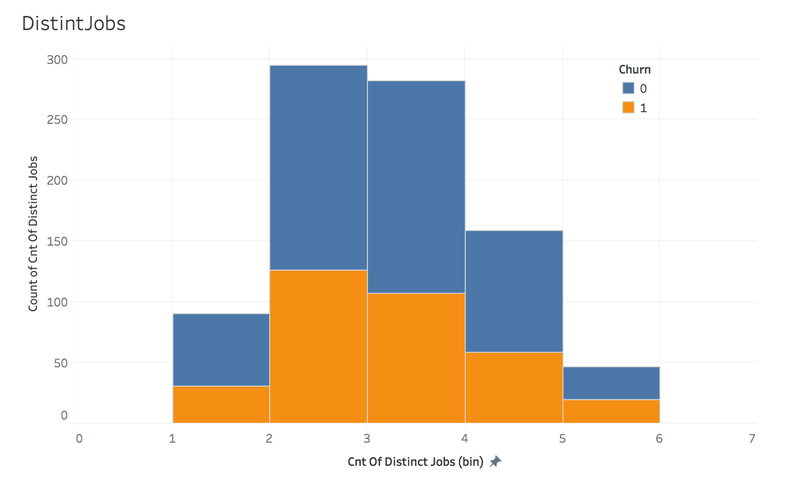
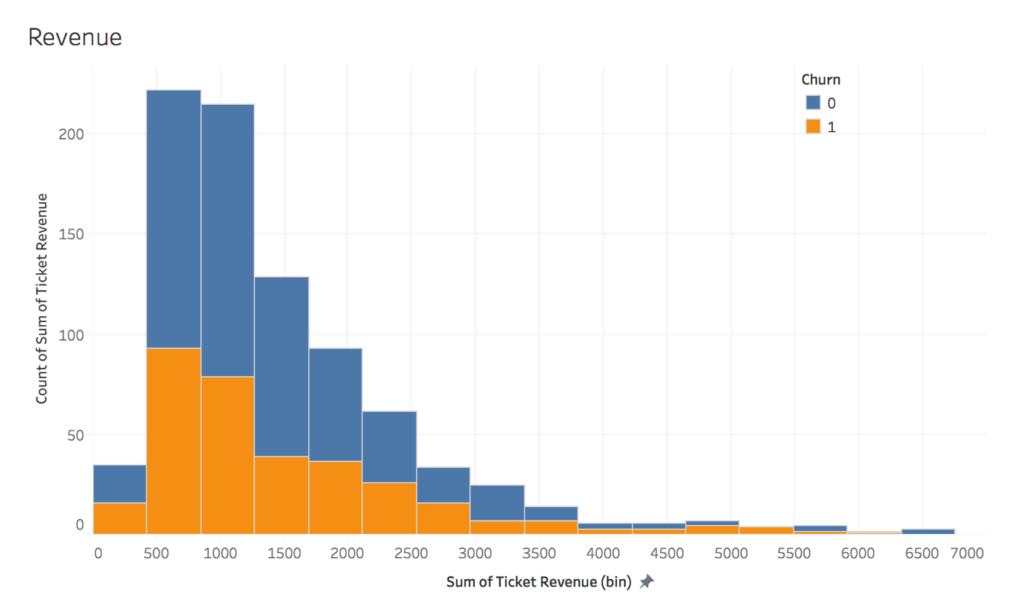
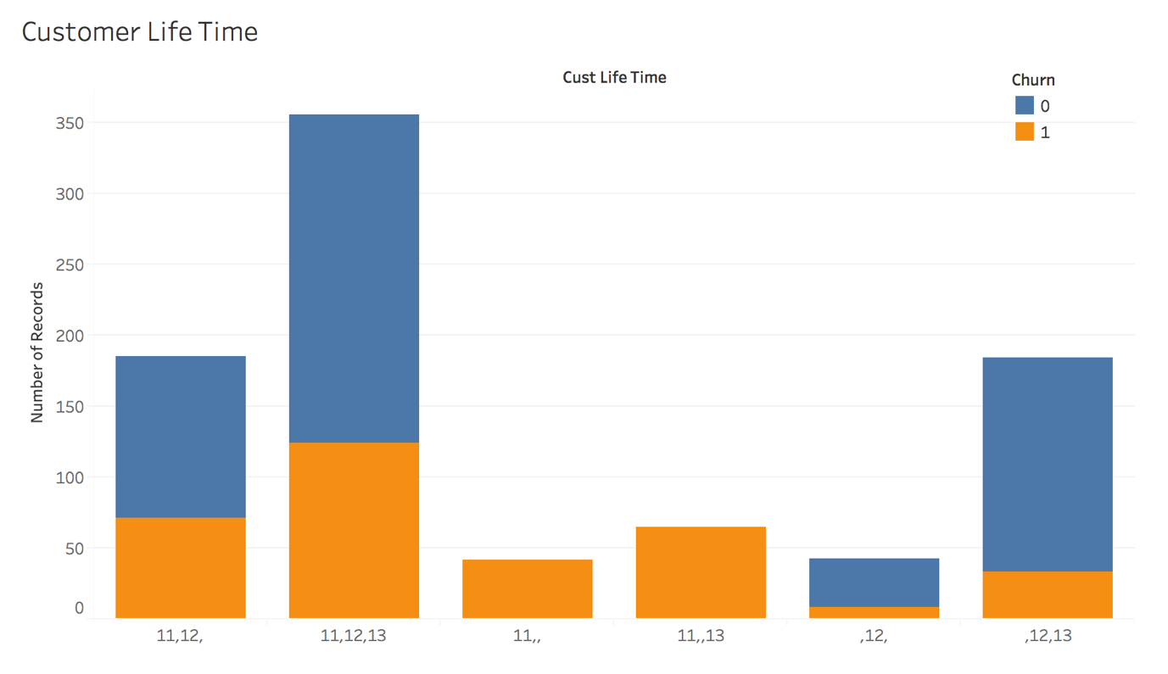

Slide 25
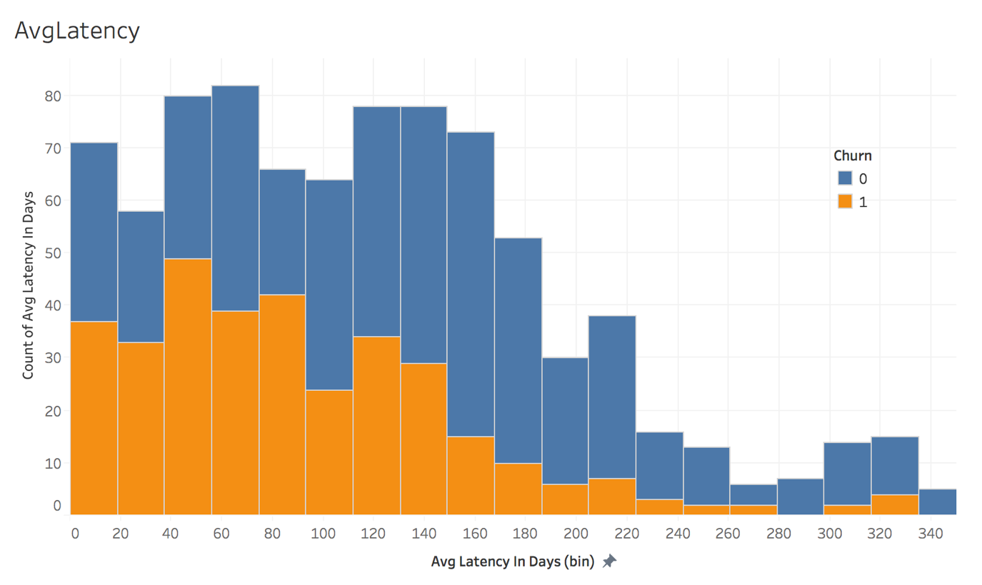
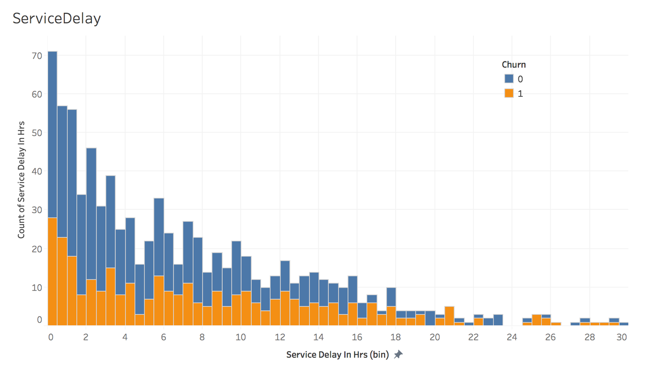
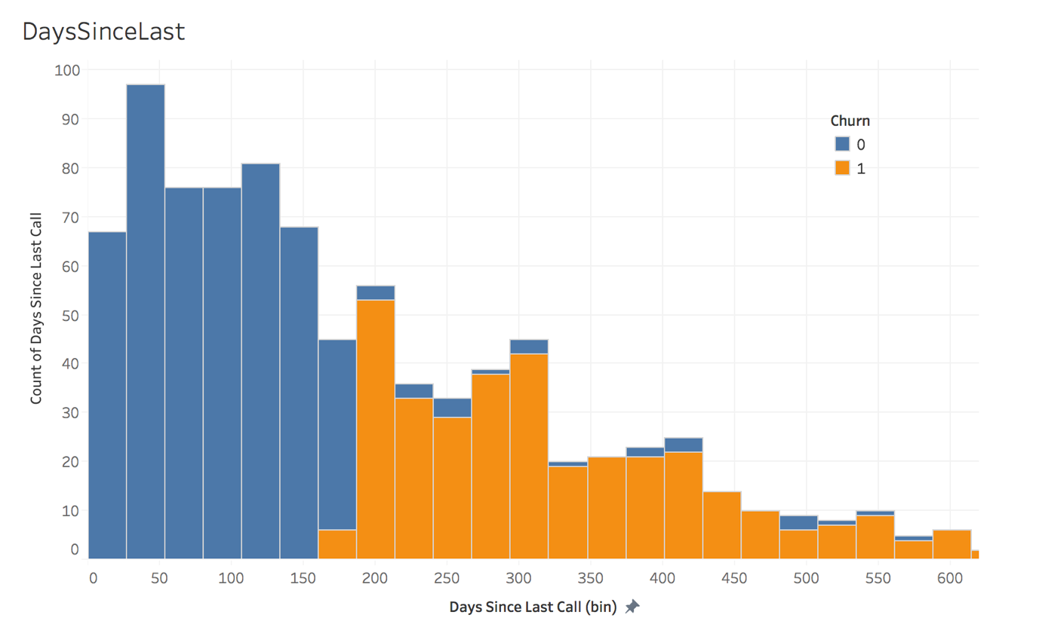
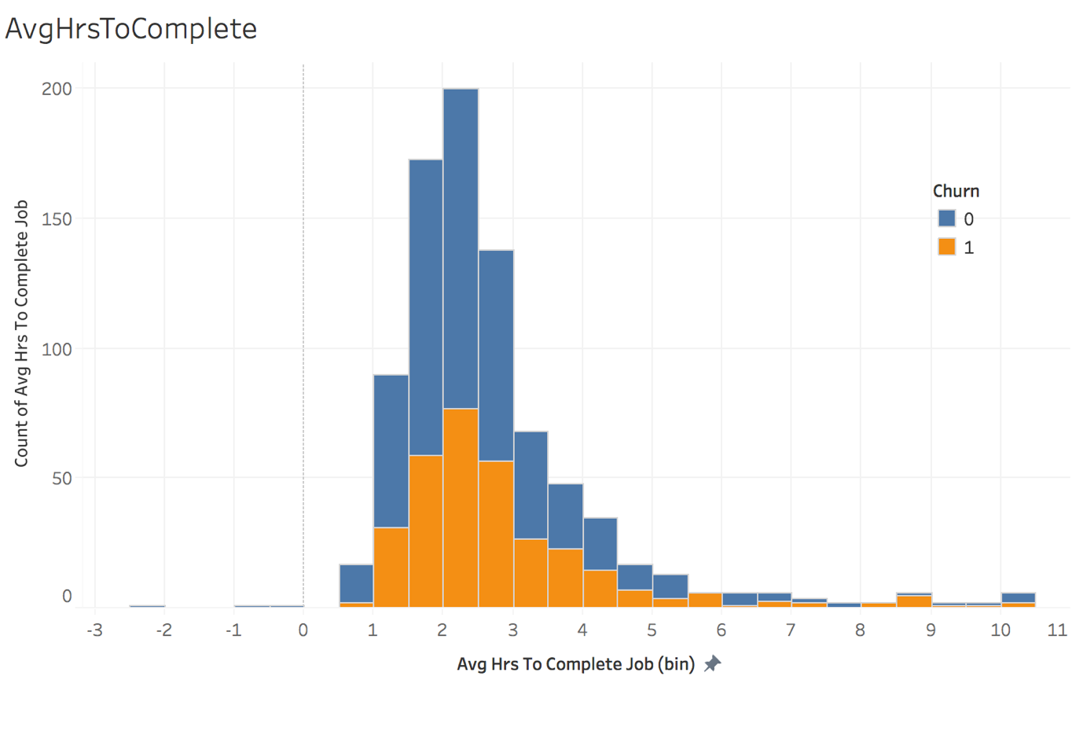

Slide 26
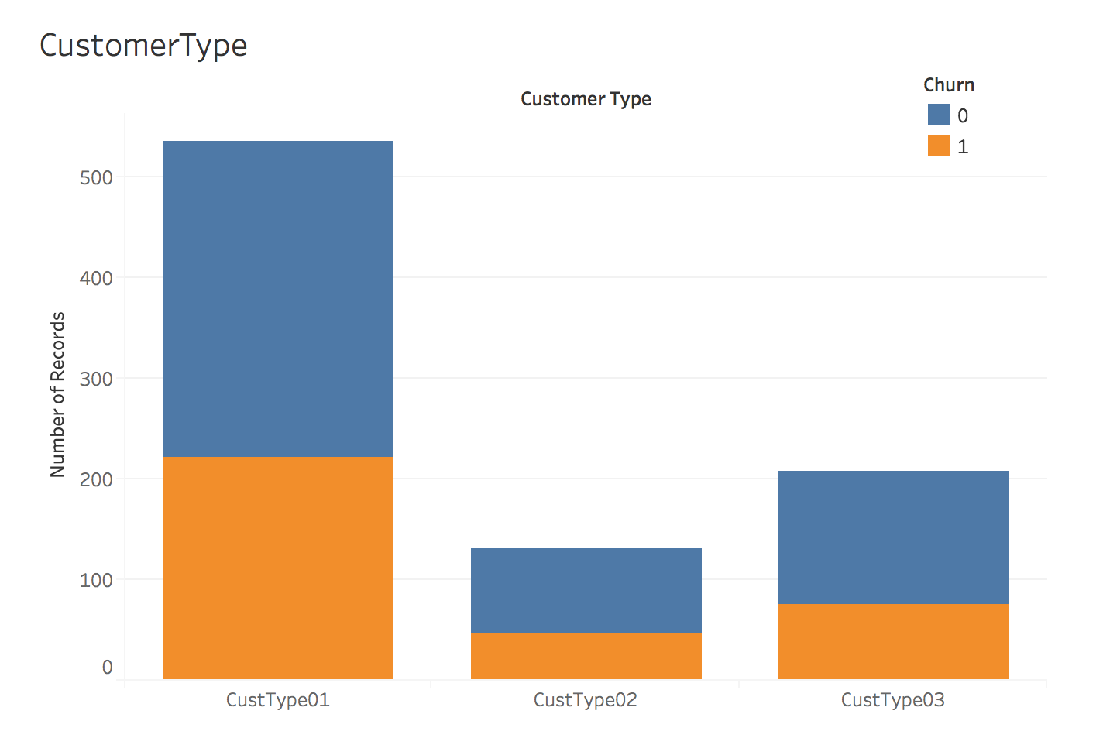
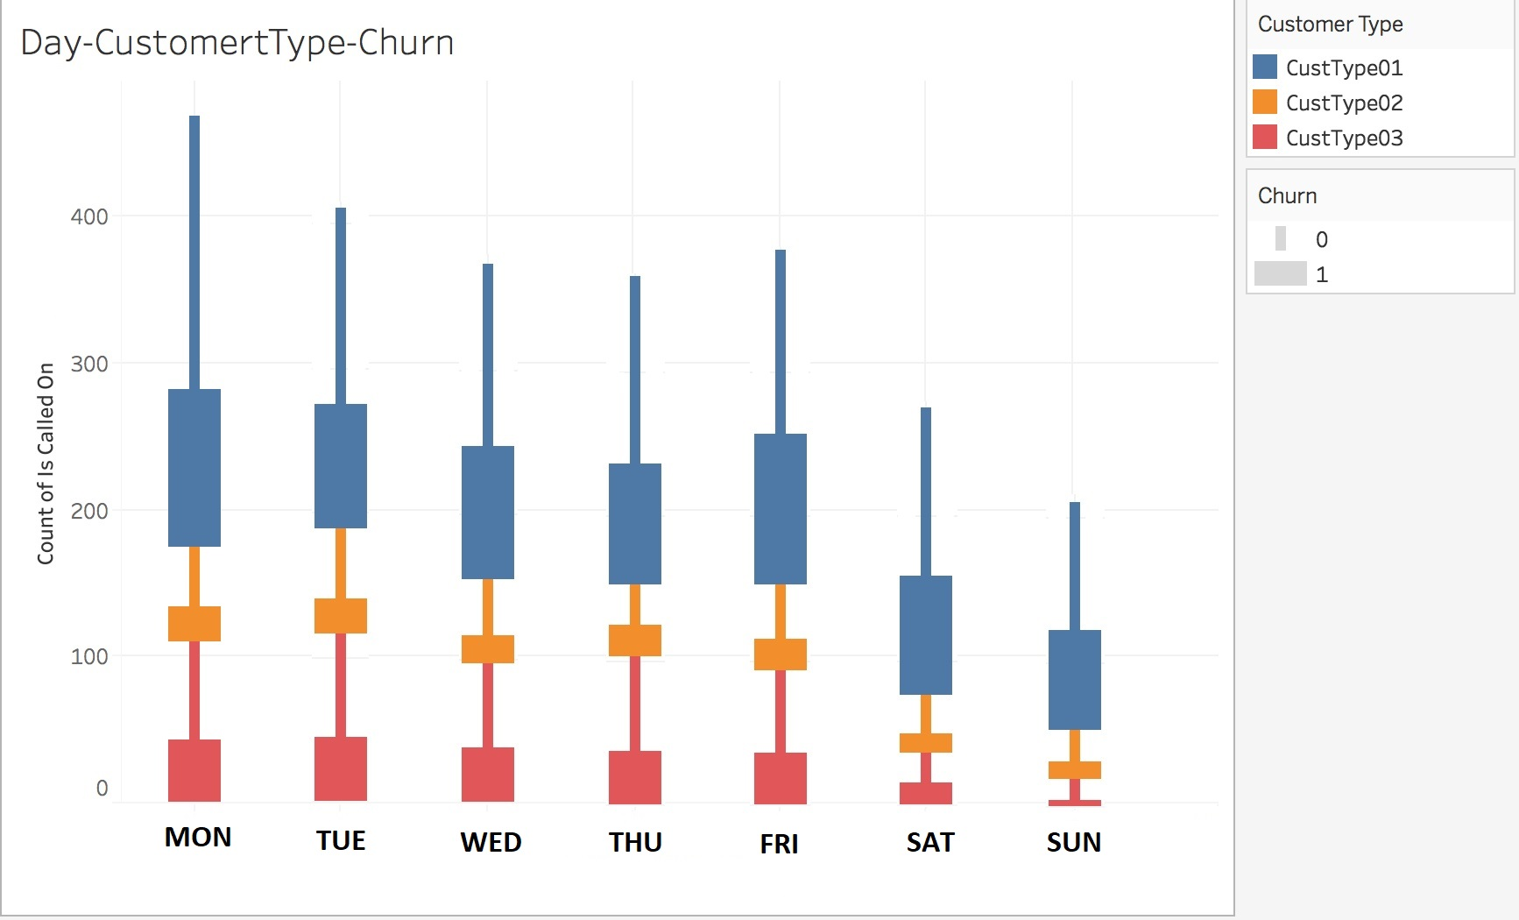

Slide 27
Hypothesis Testing
Plumbing Business Analysis

Slide 28
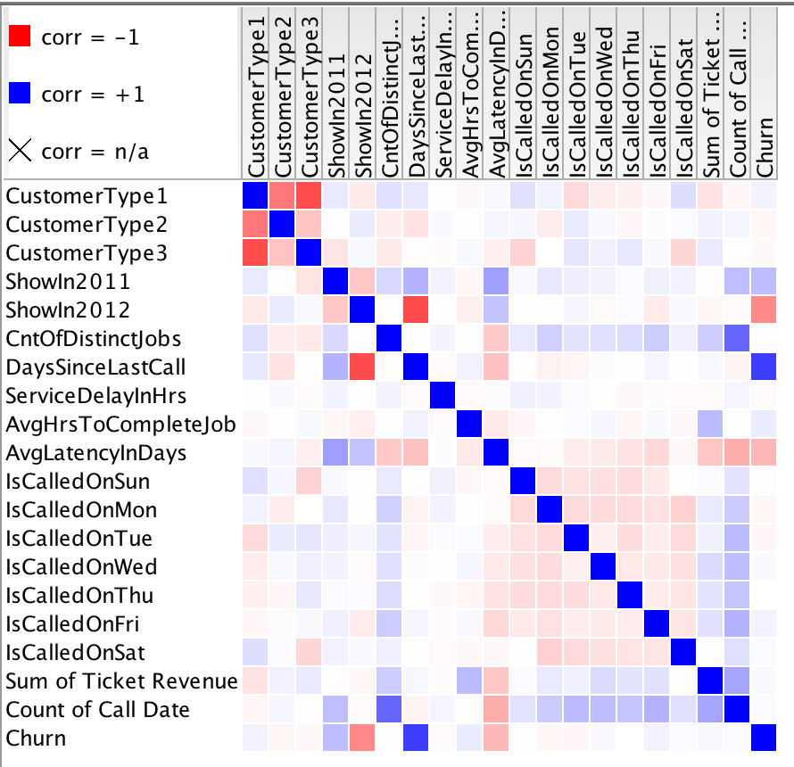
Correlation matrix:

Slide 29
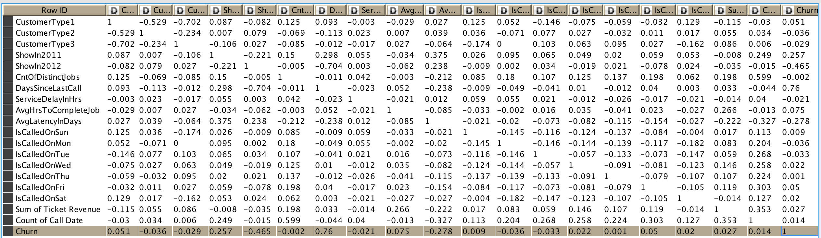
Correlation matrix table:

Slide 30
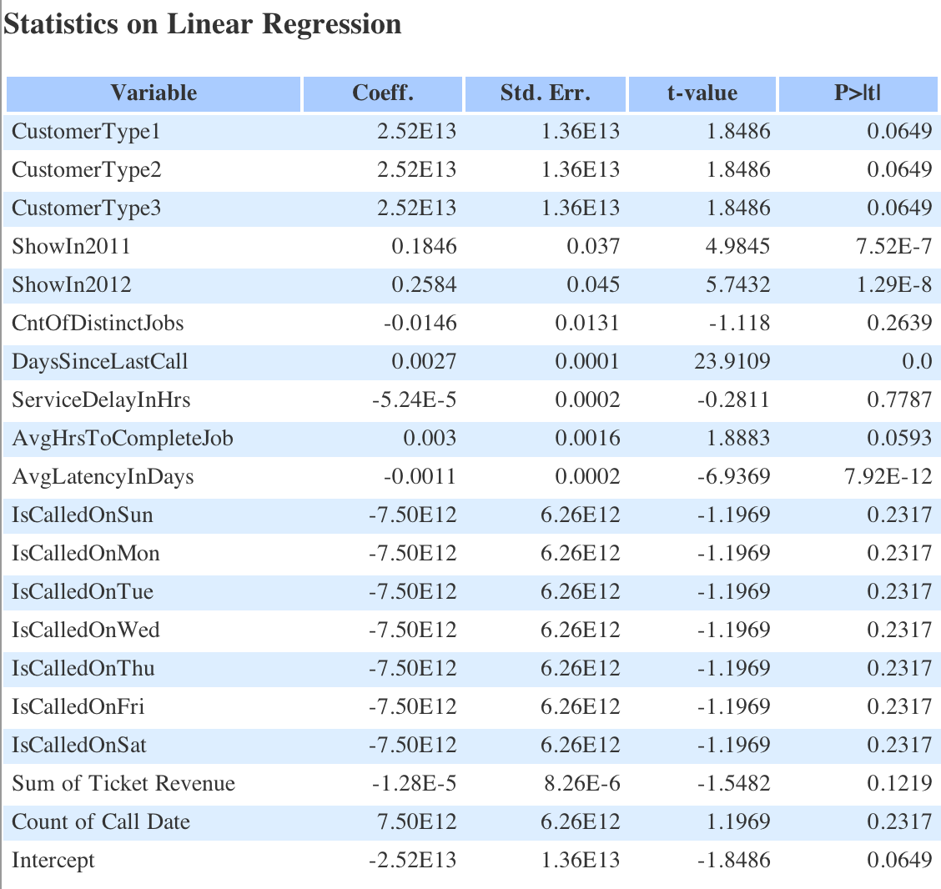

Slide 31
Summary of hypothesis testing statements
No. | Null Hypothesis statements | Accept/Reject
1 | None of the derived features contribute to predict customer churn | Reject
2 | As average number of hours to complete the job increases, probability of customer churn increases | Accept
3 | Average delay in days between service calls i.e. Avg. Latency has direct influence on customer churn | Accept
4 | More the number of distinct jobs used by customer, lesser is the probability of customer churn | Reject
5 | More the number of service calls made by customer, lesser the probability of customer churn | Reject
6 | As days since last call increases, probability of customer churn increases | Accept
7 | More the delay to pick up scheduled service calls, higher the probability of customer churn | Reject
8 | Higher the total revenue from customer, lower the probability of customer churn | Reject
9 | Service call day of a week does influence customer churn | Reject
10 | If customer uses service in consecutive years, then there is less chance that the customer churns | Accept

Slide 32
List of Significant Variables for Model Building
Variable | p-Value
Called for services in previous year (ShowInPrevYear) | 7.25E-07
Called for services in current year (ShowInCurrYear) | 1.29E-08
# of days since last call for services (DaysSinceLastCall) | 0
Average time (hours) taken to complete a task (AvgHrsToCompleteJob) | 0.05
# of days elapsed between consecutive service calls (AvgLatencyInDays) | 7.92E-12

Slide 33
Lets Build Model
Plumbing Business Analysis

Slide 34
POC and Model selection
KNIME for our POC and built 4 different models on cleaned training data and evaluated their prediction performance.
We used the 5 variables that were shown to be significant during our hypothesis testing studies and tested them using the following 4 models to predict churn.
Logistic Regression
Random Forest
Decision Tree
Naïve Bayes

Slide 35
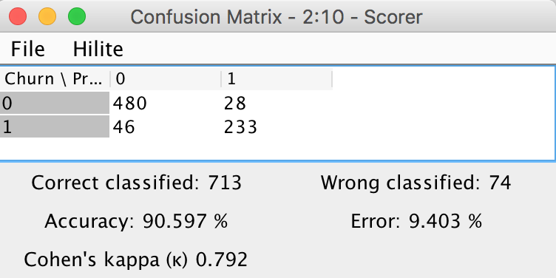
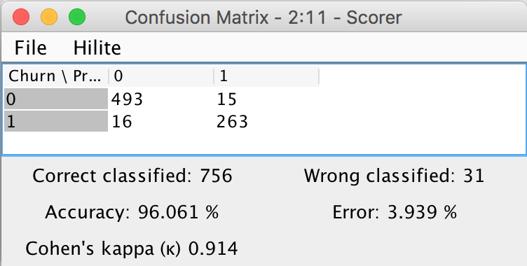
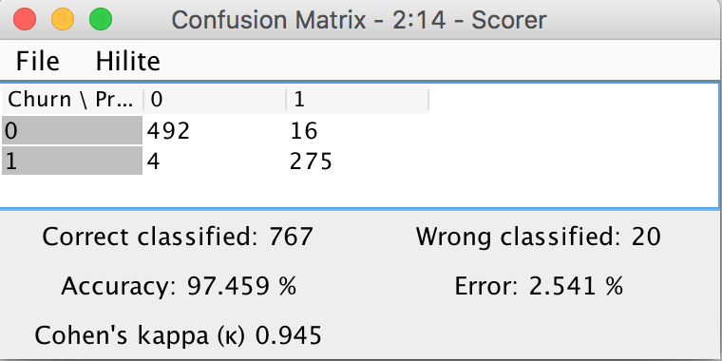
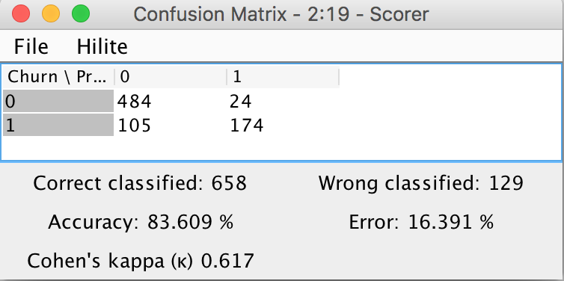
Logistic regression
Random Forest
Decision Tree
Naïve Bayes

Slide 36
Final Model using R
Plumbing Business Analysis

Slide 37
Random Forest(RF)
RF model outperformed others to predict churn data –
We built Full RF model using RFDF.dev dataset prepared in EDA&P
Plot OOB chart and rebuild pruned RF model based on OOB
Create deciles and then Rank order for development model based on predicted output
Calculate and print Rank table, auc, ks, gini and confusion matrix on dev. sample(refer screenshot on next slide)

Slide 38
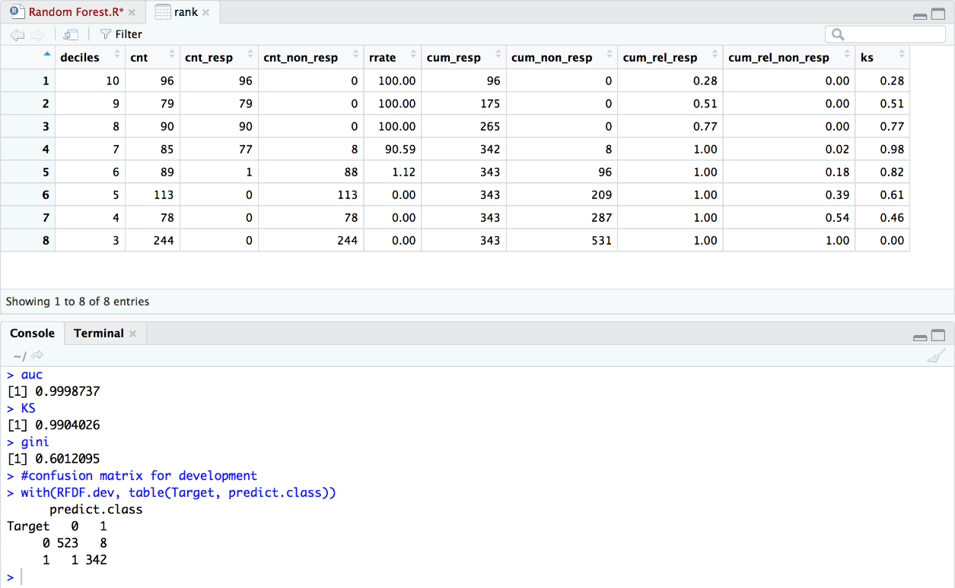

Slide 39
Analyzing RF development model performance
Looking at performance measure of development Model rf1:
Rank table: Top 3 decile has 100% response rate i.e. 2.6times 39% overall response before applying RF algorithm.
Confusion Matrix: Correctness of prediction is 98.9%.

Slide 40
Run RF model on Holdout data

Slide 41
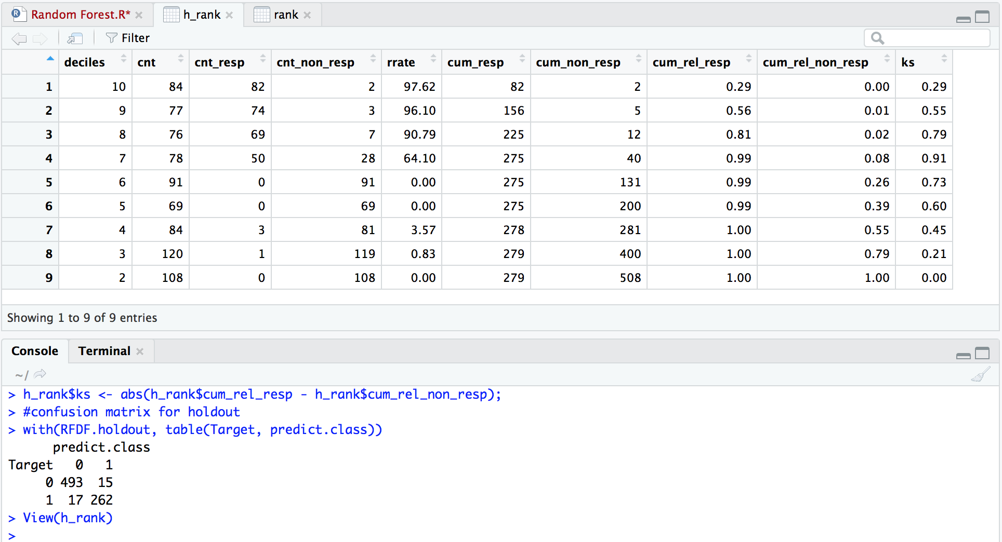

Slide 42
Analyzing RF model on unseen holdout data
Looking at performance measure of Model rf1 on unseen data:
Rank table: Top decile has 97.62% response rate i.e. 2.8 times 35% overall response before applying RF algorithm.
Confusion Matrix: Correctness of prediction is 95.9%.

Slide 43
Close agreement between development and holdout data
 | Test Data (Validation) |  |  | Holdout Data (Validation)
 | True Positive (TP) (0) | True Negative (TN) (1) |  | True Positive (TP) (0) | True Negative (TN) (1)
Predicted Positive (P) (0) | 523 | 8 |  | 493 | 15
Predicted Negative (N) (1) | 1 | 342 |  | 17 | 262
Accuracy | 98.97 % |  |  | 95.90 %
0 | Not Churned
1 | Churned

Slide 44
Conclusion
Business is mostly flat throughout 2011 to 2013 with slight increasing trend
There are total 47 branches and avg. weekly calls is 33. We can say there are few branches who do not get even one single call in a week
There are few Jobs asked by customers most and they contribute major in total revenue.
Strange but real: This is the business where cream customers tend to churn most and attribute to ad-hoc work requirements.
> Customer Type 1 formed the bulk of customers and were also found to churn the most

Slide 45
Recommendation
To retain cream customer: We recommend company to start Annual Maintenance contract program for their loyal customers. One of the way churn can be controlled to some extent
There are many Jobs hardly used and can be delisted from the services offered by the company
63% of total service calls are from returning customers. We recommend up selling and cross selling to existing customers which will help increase the company’s share in customer wallet
There are several branches which contribute very less to the overall revenue. These branches can either be combined with other branches, try applying a few recommendations listed above to see if business improves, or closed the branch if it continues with its poor performance
The company also needs to build a better CRM system, find CLV values, prepare website with geographical details, accept online service requests, use chat bots, web analytics system and other services to improve performance

Slide 46
Thank You

